Slide 1
This is a hidden slide
Dear honorable teacher please follow the instructions that has given in the slide notes (under the every slide). It would be helpful to take a successful class. Thanks a lot. I wish you good luck.

Slide 2
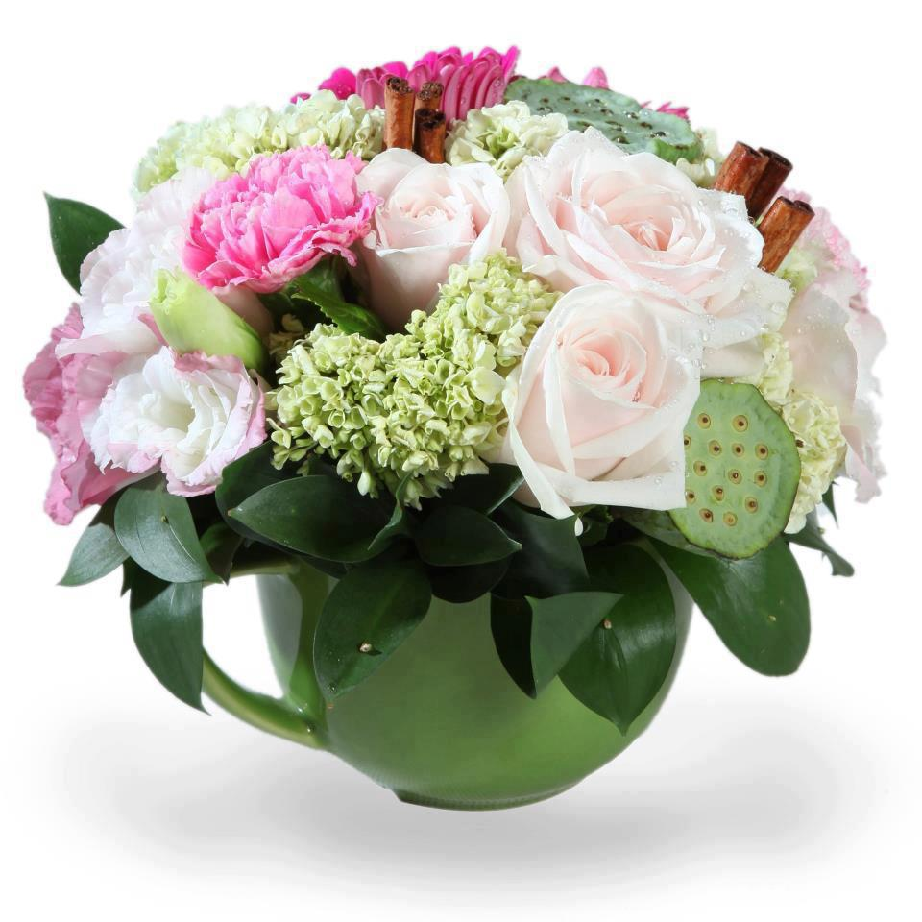
WELCOME

Slide 3


IDENTITY
SK. Md. Harunar Rashid
Senior Assist: Teacher
Sonatola Model High School,
Sonatola, Bogra.
Lesson
ENGLISH FOR TODAY
CLASS : SIX
UNIT ---- LESSON – 26

Slide 4
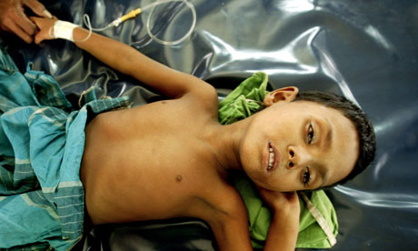
Look at the pictures
S: Yes, recently I have had a cholera.
T: What did you do when you have had cholera?
S: I went to a doctor for my remedies.
T: Have you had any health problems recently ?
Notes:
Teacher can ask the students to talk this condition in pairs.

Slide 5
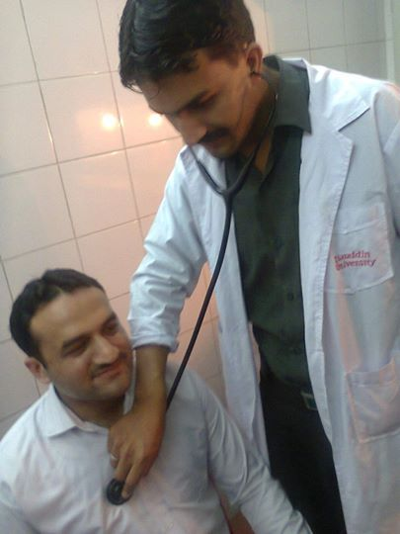
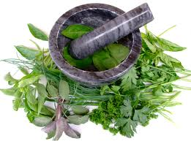
LESSON DECLARATION
So today we`ll discuss about
Remedies:
modern and traditional.

Slide 6
Learning outcomes
By the end of the lesson, students will be able to----
read and understand written instructions
read and understand texts
ask and answer questions
Write short paragraphs
Participate in short dialogues and conversations on familiar topics

Slide 7
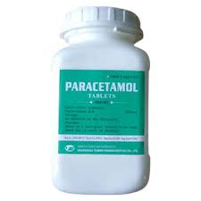

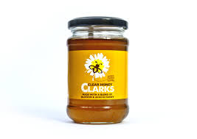
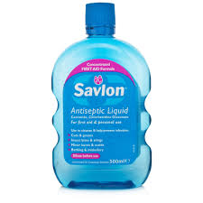
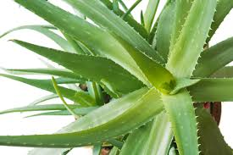

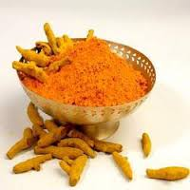
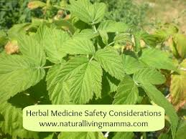
Look at the following pictures. Discuss with your partner what they are. Match them with their names given in the box.
Paracetamol,
Holy basil/Tulsi,
Antacid,
Honey,
Neem,
Savlon,
Turmeric,
Alovera.
Notes:
Teacher will give sometime to elicit correct answer, then he/she will give the feedback.

Slide 8
Section - A
Read the text carefully then separate the Natural cures and Chemical cures. One example is shown
Natural cures | Chemicals
Honey | Savlon
Neem
Turmeric
Aloevera
Holy basil / tulsi
Paracetamol
Antacid
Burnol ointment
Notes:
Teacher can ask students to underline the clues.

Slide 9
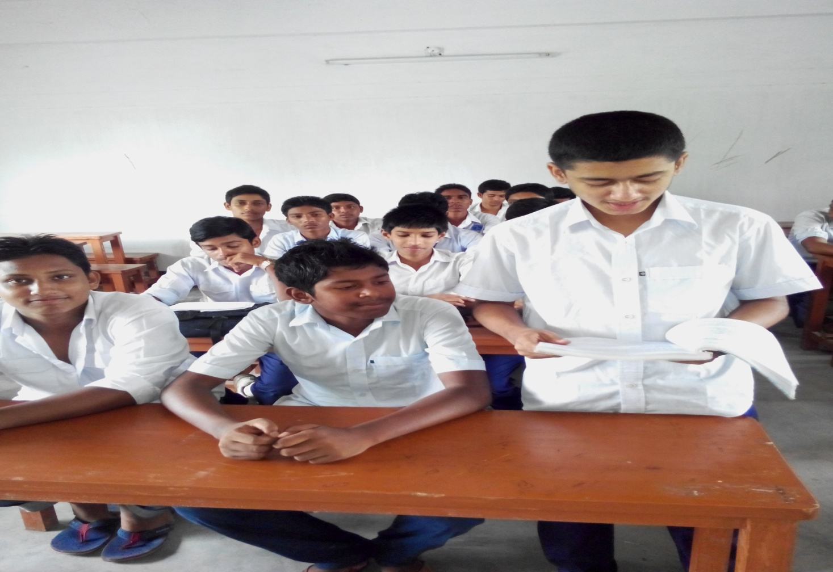
Loud reading
Notes:
Teacher can help the students. If they do wrong.

Slide 10
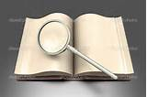
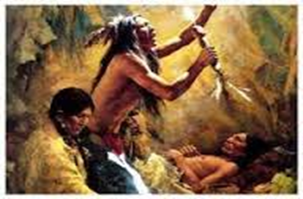
ancient
Key word
They are ancient people and used herbal medicines.
Meaning
(Click here)
Old / before
Notes:
First, the word will be shown, SS will be asked to pronounce the word. If it needed teacher will help. Then the picture will be shown and asked to guess the meaning. After that the meaning will be shown. Then they will be asked to make sentence. Teacher will show the students for the feedback. Slide 9, 10 and 11.

Slide 11
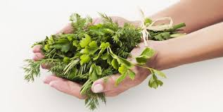
Herb
Key word
Herbel remedies are not new system.
Meaning
(Click here)
Natural Medicine

Slide 12
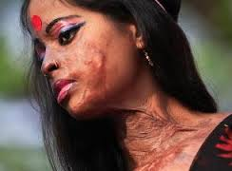
Burn
Key word
For burn herbal medicines are aleovera or honey.
Meaning
(Click here)
Injury

Slide 13
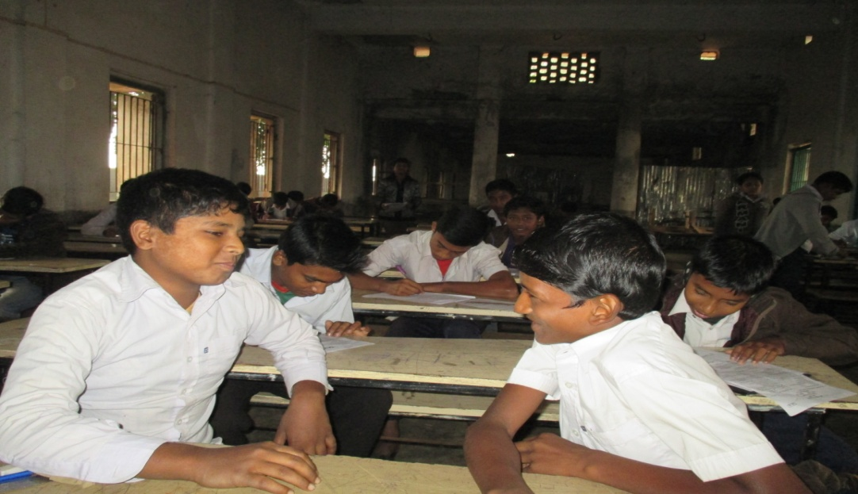
Pair works
Read the text again then ask and answer
the following questions :-
Natural cures are made of natural things, most often herbs and plants.
Herbal cures are not modern invention. They are ancient.
For skin problems, garlic, neem or turmeric is used.
Are herbal cures modern inventions?
What herbal cures are used for skin problems?
What are natural cures made of?
Notes:
After showing the conversation teacher will call 2/3 pairs for practice.

Slide 14
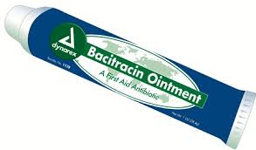

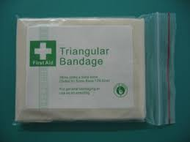
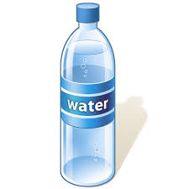
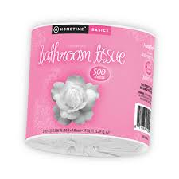
Look at the picture and try to say what is this? your answer must be within a sentence.
A tube of ointment
A box of aspirin
A bottle of water
A package of tissue
A package of bandages
Let`s go to next slide
Notes:
Teacher will give sometime to elicit correct answer, then he/she will give the feedback.

Slide 15
Individual work
Complete the following expressions with words from the box.
Bottle, box can package tube
tube
a ……………………. of ointment
a ……………………. of aspirin
a …………………… of bandage
a ……………………. of foot spray
5. a ……………………. of tissue
box,
package,
bottle/can
package,
Now write down some sentences using these phrases:
One is done for you. I have bought a tube of ointment.
Notes:
Teacher can elicit the answer by orally.

Slide 16

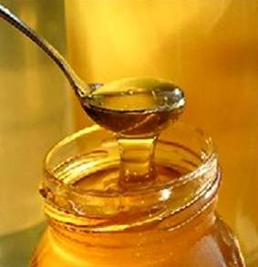
HOME WORK
Write the benefit of honey.

Slide 17


